Slide 1
Introduction of the Medical Examiner for South Wales Central and South Wales East
January 2021
Dr Jason Shannon Lead Medical Examiner for Wales
Rachel Jones Senior Medical Examiner Officer for South Wales East
Nick Denny Senior Medical Examiner Officer for South Wales Central

Slide 2
Background to the service
Patient Safety
Numerous reviews (e.g. Shipman, Mid Staffs, Morecombe Bay, Gosport) concluded that there was insufficient scrutiny of death and recommended the introduction of Medical Examiners
Professor Stephen Palmer in his independent review of RAMI (2014) strongly recommended individual case record reviews as a way of identifying areas of care that could be improved.
Stage 1 Mortality Reviews are undertaken in Wales to identify cases that require a Stage 2 review, but these are only done for people who die in acute hospitals and are not necessarily done consistently, systematically or independently.
Case records are not routinely reviewed for those who die outside of an acute hospital (around 50% of all deaths).

Slide 3
Background to the service
Death Certification Accuracy
Some studies (e.g. Mid Staffs, ME Pilots) suggest around 20% of stated case of death on MCCD not consistent with medical records
45% of all MCCDs submitted fail to meet minimally acceptable standards (DHSC Impact Assessment quoted study). Wales audit shows around 20% unable to be registered (Dec 19)
Health Policy often based on mortality statistics
Distress for the bereaved
Not always at the centre of the process
Not always given the opportunity to raise questions
Not always satisfied with independence of responses

Slide 4
The Vision
A single, all Wales Medical Examiner Service, working on behalf of Health Boards in both Primary and Secondary Care.
Improve the quality of death certification by:
Providing expert advice to doctors (QAP) based on a review of relevant health records
Strengthen safeguards for the public by:
Providing robust, systematic and independent scrutiny of all deaths not referred directly to the Coroner (cause of death and circumstances surrounding it)
Providing intelligent analysis and system level reporting of concerns found during scrutiny, and
Ensuring that the right deaths are referred to a Coroner and to individual care organisations where appropriate
Avoid unnecessary distress for the bereaved by:
Answering questions about the certified cause of death or care given, or that arise from unexpected delays when registering a death

Slide 5
The Service Model
Scrutiny of every death not referred directly to a Coroner, in order to systematically answer 3 key questions
What did the person die from?
Does the death need to be reported to a Coroner?
Are there any clinical governance/patient safety concerns that need further investigation?
Delivered by independent, trained Medical Examiners, supported by trained Medical Examiner Officers, using a standard methodology
Expanded Stage 1 Mortality Review on ALL deaths not referred directly to a Coroner
Using 3 key component sources of information
Clinical Notes
Qualified Attending Practitioner
Next of Kin
With reporting links to other systems
Care Providers
Coroner Services
Registration Services
NB: The Service does not regulate or investigate

Slide 6
Initial roll out in Princess of Wales Hospital and Ysbyty Ystrad Fawr
Initial soft start within Cwm Taf Morgannwg and Aneurin Bevan to ‘go live’ with the new Medical Examiners Service
Started scrutinising cases from September 2020
Once we’ve reviewed the death, spoken to the medical team and the bereaved, we issue a form called an ME2. Once the service is statutory the MCCD can only be registered on receipt of the Medical Examiner documentation (ME2).
At this point the certificate can be sent to the Registrars and feedback provided to medical/nursing and hospital teams if required.

Slide 7
Proposal for deaths within Primary Care
Death occurs - Verification of the death
GP documentation- Add final entry in patient records, documenting proposed cause of death, any concerns or reasons to refer to the Coroner.
Nominated individual within the practice notifies Medical Examiner Service of the death - Information passed to the ME Service with consideration of timescale, faith deaths etc, by phone or email.
Notes reviewed by the ME Office - First part of the scrutiny is completed by the Medical Examining Officers and then by the Medical Examiner within information from EMIS or Vision.

Slide 8
The Process in stages
Medical Examiner Office will notify nominated individual that the scrutiny is complete – The GP can now complete the MCCD or discuss further with the Medical Examiner Office where there is a need for further discussion.
MCCD completed – The MEO will email a confirmation of what has been agreed to the GP Practice.
Coroner referral needed – Potential for the Medical Examiner Service to undertake this step on behalf of the GP.
MCCD scanned and sent to ME Service – The Medical Examiner
Service will then cross check with what’s been agreed

Slide 9
The Process in stages
Medical Examiner Officer Speaks to the Bereaved – Probably the most important level of scrutiny and a very powerful element to the service.
ME2 is completed by the Medical Examiner – The Medical Examiner completing this document could be different to the initial Medical Examiner. This gives an extra level of scrutiny.
ME Office sends MCCD to Registrar’s Office along with ME2 – At this point our paperwork and process is completed.
Death is now registered – The death is registered with the NOK, previously this was the point where the NOK could find out the cause of death.

Slide 10
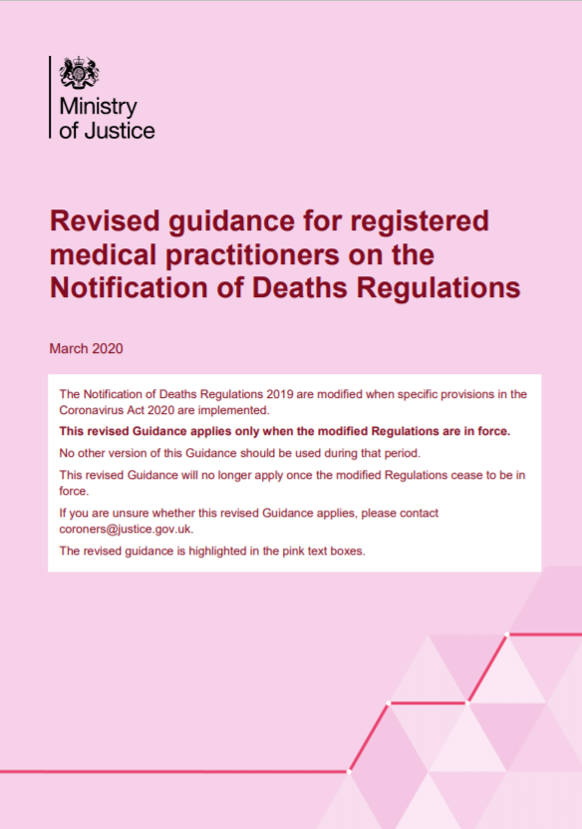
Coroner referrals
If there is a clear need for Coroner referral (e.g. RTC, suicides, major trauma, maternal deaths, occupational deaths) the attending Doctor/Clinical Team is to refer the case directly to Coroner.
Please don’t hesitate to contact us to discuss cases or guide referrals appropriately.
If we identify a need for Coroner referral, we will ask you to complete the Coroner referral form and email it to the ME Service.
We will then send your Coroner referral plus our Medical Examiner opinion onto the Coroner.

Slide 11
Feedback
The bereaved often have words of thanks/compliments to pass on to medical staff and that is something we will capture and feedback to staff.
If concerns are identified, we are able to highlight this and feedback appropriately to the Health Board. This is dependant on the nature of the concern as to how it’s dealt with.

Slide 12
How to contact us
Senior Medical Examiner Officer for South Wales Central;
Rachel Jones Rachel.Jones38@wales.nhs.uk Tel: 01495 30 0864
ME Office email address: SouthWalesEast.MedicalExaminersOffice@wales.nhs.uk
Senior Medical Examiner Officer for South Wales Central;
Nick Denny Nicholas.Denny@wales.nhs.uk Tel: 02920 905434
ME Office email address: SouthWalesCentral.MedicalExaminersOffice@wales.nhs.uk

Slide 13
Thank you for listening

